Slide 1
ASSIGNMENT
10-04-2025

Slide 2
Understanding CPU, Server, and Databases
A breakdown of key computing concepts

Slide 3
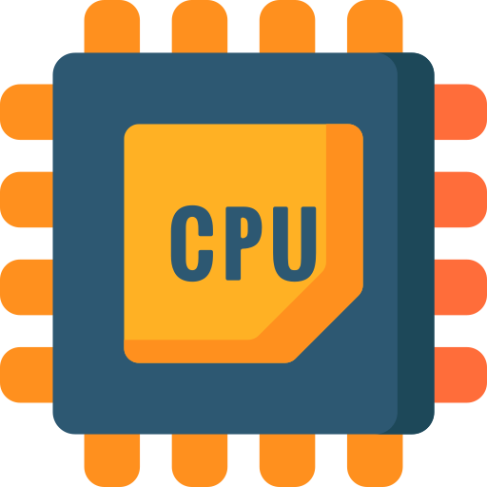
How the CPU Works & Its work process
CPU (Central Processing Unit) is the brain of a computer.
It performs all the arithmetic and logical operations.
Works in Fetch–Decode–Execute cycles:
Fetch: Retrieves instructions from memory.
Decode: Understands what the instruction means.
Execute: Performs the required task.
Store(Optional): Saves result in memory or register.
Processes: A process is a program in execution. Each process may have multiple threads running inside.
The CPU continuously: ➡ Fetches → Decodes → Executes → (Stores) instructions to run programs and perform system operations.

Slide 4

Main Components of a Server
Server: A powerful system that provides services to other systems over a network.
Main Components:
CPU – Handles processing tasks, High-performance processors (e.g., Xeon)
RAM – Temporary data storage for running services, Large capacity for multitasking.
Hard Disk/SSD – Permanent data storage.
Network Interface Card (NIC) – Handles network communication.
Power Supply Unit (PSU)
Motherboard – Connects all components.

Slide 5

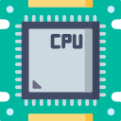
Difference Between CPU and Server
Feature | CPU (Central Processing Unit) | Server
Definition | Core component of a computer that executes instructions | A complete system that provides services to clients over a network
Function | Performs calculations, logic, and control tasks | Hosts applications, stores data, and responds to network requests
Role | Acts as the “brain” of a computing device | Acts as a service provider in a network
Hardware Type | A single chip or processor | Includes CPU, RAM, storage, NIC, and more
Users | Used by individual systems (PCs, laptops, etc.) | Serves multiple users/devices simultaneously
Examples | Intel i7, AMD Ryzen | Web server, File server, Database server

Slide 6
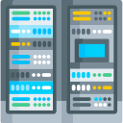
Processes Running in Server & CPU
CPU Processes:
The CPU handles many types of processes such as:
User Processes – Running applications (e.g., browsers, editors).
System Processes – Background services (e.g., OS management, scheduling).
The CPU uses multitasking to switch between processes quickly.
Processes are scheduled by the Operating System (OS) using algorithms.
Server Processes:
Servers often run specialized and long-running processes, such as:
Web Server Processes, Database Server Processes, Authentication Services, File Sharing Services, Monitoring Tools, Task Schedulers & Job Queues, monitoring daemons.

Slide 7
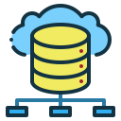
What is RDBMS? How Data is Accessed?
Relational Database Management System(RDBMS)
Stores data in structured tables made up of rows and columns.
Each table represents a relation, and each row is a record.
Supports data integrity, relationships, normalization.
How data is Accessed?
SQL (Structured Query Language) is used to access and manipulate data.
Uses SQL: SELECT, INSERT, UPDATE, DELETE
Examples: MySQL, PostgreSQL, Oracle, SQL Server.

Slide 8
Differences Between DBMS & RDBMS
Feature | DBMS | RDBMS
Data Storage | Stores data as files, sometimes in hierarchical or navigational models | Stores data in tables (rows and columns)
Relationship Support | Doesn’t support relationships between data | Supports relationships using foreign keys
Data Integrity | Not strictly enforced | Enforces data integrity with constraints
Normalization | Not supported or rarely implemented | Supports normalization to reduce redundancy
Multi-user Access | May not support multiple users effectively | Designed for multi-user access
Examples | File systems, XML, DBMS like dBASE | MySQL, Oracle, SQL Server, PostgreSQL
Security | Basic or limited security features | Advanced security with access control and roles
ACID Compliance | May not be fully ACID-compliant | Fully ACID-compliant for transaction safety

Slide 9
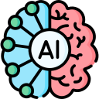
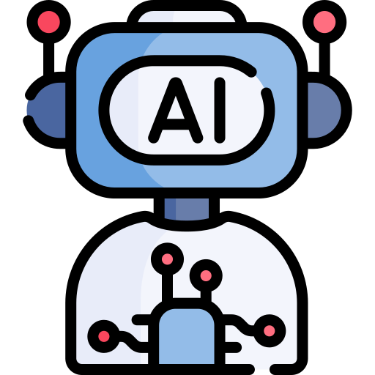
Responsible AI & Business AI
Responsible AI refers to the practice of designing, developing, and deploying artificial intelligence systems in a trustworthy, ethical, and accountable way.
Business AI focuses on using artificial intelligence to achieve business objectives, improve performance, and drive innovation.
Difference between them:
Aspect | Responsible AI | Business AI
Focus | Ethics, fairness, accountability | Profit, efficiency, innovation
Goal | Safe and fair AI | Effective and profitable AI
Concerned With | Bias, transparency, compliance | Speed, automation, decision-making
Used By | Governments, regulated sectors, NGOs | Enterprises, startups, business teams

Slide 10
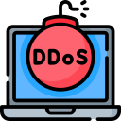
DDOS
DDoS stands for Distributed Denial of Service.
It is a type of cyberattack where multiple systems flood the resources of a target server, website, or network, making it slow or completely unavailable to users.
How Does DDoS Work?
Attackers use many devices (often infected computers called botnets) to send a massive amount of traffic to a target.
The target system becomes overwhelmed and cannot respond to legitimate requests.
As a result, services crash or become inaccessible.

Slide 11
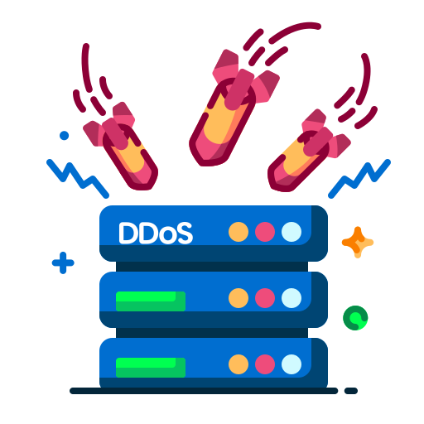

⚠️Impact of DDoS:
📌Downtime and service interruptions.
📌Financial loss and reputation damage.
📌May be used to distract while other attacks happen.
🔍How to Prevent or Mitigate DDoS?
🛡️Use firewalls and DDoS protection services.
🛡️Deploy rate limiting and traffic filtering.
🛡️Use CDNs (like Cloudflare) to absorb large traffic.

Slide 12
RISE with SAP
🌩️ RISE with SAP – Cloud Operations Overview
📌RISE with SAP is a Business Transformation as a Service (BTaaS) offering by SAP that helps companies move to the cloud with a single contract, covering software, infrastructure, and services.
☁️ What Are Cloud Operations in RISE with SAP?
📌Cloud operations refer to how SAP and its partners run, manage, and monitor your SAP systems in the cloud environment.

Slide 13
Thank you

